Slide 1
Lecture 3: More Geometry of Linear Algebra; and Definition of Regular Curves, Orientation, and Parametrized by Arclength
Math 142
Prof. Gu

Slide 2
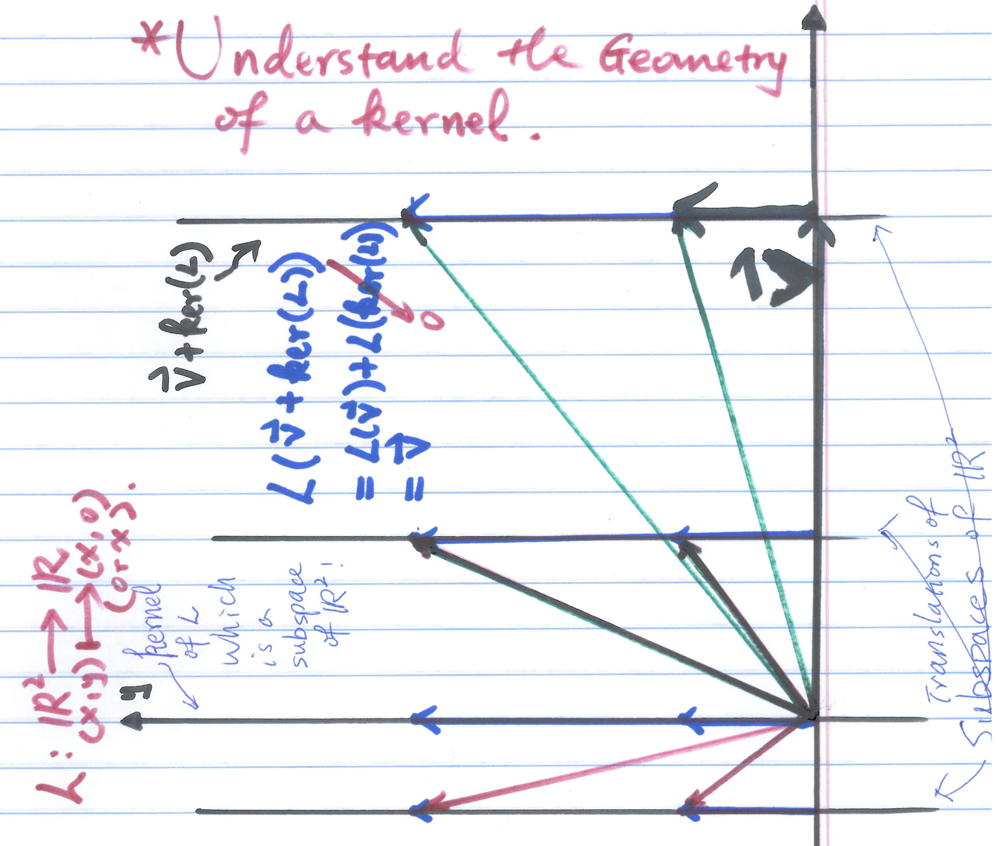
More Geometry of Linear algebra Example: Understand the Geometry of the kernel of a linear map.

Slide 3
Geometry of Inner product space
Geometry of real, complex, and quaternion numbers.

Slide 4
Outlines Only Note: All details are in the notes of Topic 2 on Regular Curves
First look at examples 1, 2, and 3 of curves in Topic 2.
What are the differences regarding differentiability, tangent vector behaviors etc.(Let the student observations )
Give a definition of a regular curve. (Key: need to put a moving frame on the curve at the end).
Subtle: we can parametrize the curve y = x by
(t, t) or (t³, t³). (Note: (t, t) is regular, but (t³, t³) is not regular! Regularity is for a given parametrized curve!).

Slide 5
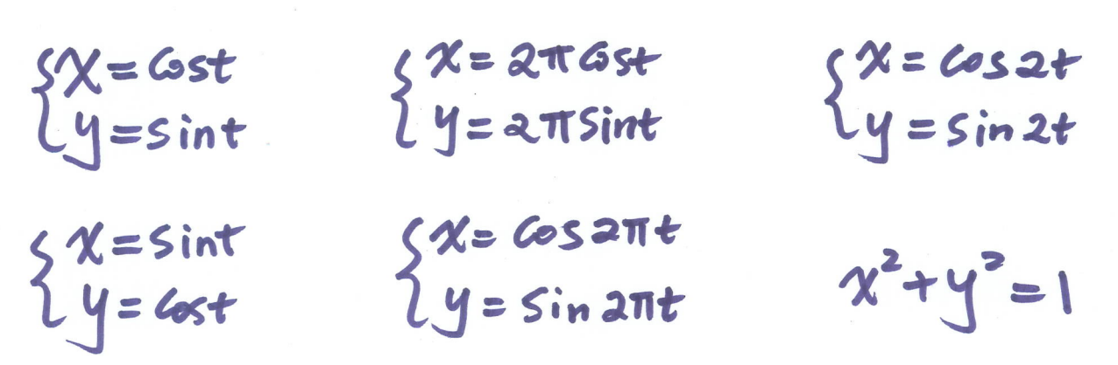
What are the differences between the following ways of describing a circle?
Let the students make observations!

Slide 6
Use the above observations to give the following definitions
Orientation of a curve
Speed
Differences between a parametrized curve and its trace
Curve parametrized by arclength
A curve can be reparametrized by arclength

Slide 7
Look at Example 4
Why is it different from the other curves we saw today?
Can we allow self-intersection for a regular curve?
Solve for the intersection.

Slide 8
An Example from Physics
How to find a parametrization for the cycloid?
Give the definition for length of a curve.
Exercise: find the length for a “complete” cycloid curve.

Slide 9
An example from Geometry
Find the intersection of the cylinder and the sphere given in Topic 2.
Let the students think about how to find the intersection first.
Give hint on how to find the intersection and therefore to see the power of using paramatrizations.
Details will be carried out in the homework.

